Slide 1
Tuesday, 07 July 2020
Acceleration Calculations
Date and title in books. What do you need? Pen? Pencil? Ruler?
Starter Activity – 5 minutes
Write down the equation that links speed, distance and time
State the units for speed,
What is the difference between speed and velocity?

Slide 2
Learning Objective
To be able to:
Know what is meant by acceleration and how it can be calculated
Key Words:
Acceleration, deceleration, velocity

Slide 3
I can state that acceleration is the rate at which an object changes its speed
I can describe the difference between the velocity of an object and its speed
I can explain what acceleration is & identify acceleration from a distance-time graph
I can calculate the acceleration of an object using the acceleration equation
I can rearrange and use the acceleration equation
Learning Outcomes

Slide 4

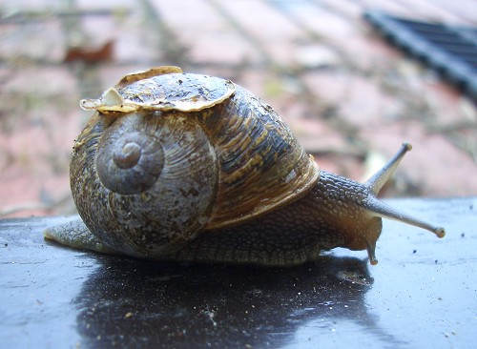
Speed
metres
Speed = distance travelled
time taken
Metres per second (m/s)
seconds

Slide 5


Recap - Calculating average speed
Average speed is calculated using this equation:
Average
speed
total distance
=
total time
Speed can be measured in different units, e.g. m/s, km/h, km/s, miles per hour.
The units of distance and time will determine the units to be used for speed.
Notes:
Describing Motion Worksheet One accompanies this slide. It has been designed to be used at any point in the presentation to help to reinforce how speed is calculated. This worksheet involves an outdoor activity.

Slide 6

Recap - Words and units

Slide 7
Speed v velocity?
Watch this video (up to 1min 18s) to find out the difference between speed and velocity – write down what you find out on your whiteboard;
Notes:
https://www.youtube.com/watch?v=Jyiw6KkedDY

Slide 8
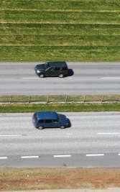
A useful definition
Two cars are travelling on a road in opposite directions. One is travelling east at 20m/s and the other is travelling west at 20m/s. Their speeds are exactly the same.
However, their velocity’s are different. What do you think their velocity’s are?
Velocity is the speed of an object in a given direction. Two objects can have the same speed, but very different velocities

Slide 9
Watch this video and answer these questions:
What is acceleration?
What is deceleration?
What two things can affect acceleration?
What are the units for acceleration?
What is constant acceleration?
What does increasing acceleration look like on a velocity-time graph?
Notes:
https://www.youtube.com/watch?v=xdHPTYYBTn8

Slide 10
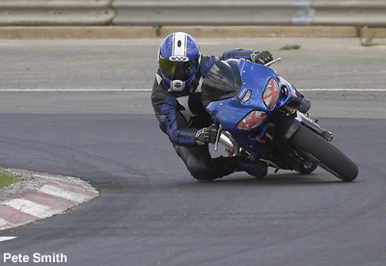
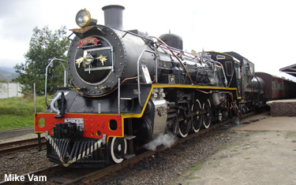
What is acceleration?
The acceleration of an object is a measure of how quickly its speed changes.
The brakes on this motorcycle are causing it to slow down. This is negative acceleration. Negative acceleration is often called deceleration.
Notes:
Photo credit (top left): Mike Vam
Photo credit (bottom right): Pete Smith
10
Boardworks GCSE Additional Science: Physics
Acceleration

Slide 11
How is acceleration calculated?
The acceleration of an object can be calculated using this equation:
acceleration =
change in velocity
time taken
Change in velocity is measured in metres per second (m/s).
Time taken is measured in seconds (s).
Acceleration is measured in metres per second per second (m/s²).
Notes:
11
Boardworks GCSE Additional Science: Physics
Acceleration

Slide 12
Developing the formula
The formula to calculate acceleration can also be written as:
(v–u)
t
a =
a is acceleration, measured in m/s².
v is the final velocity in m/s.
u is the initial velocity in m/s.
t is the time taken, measured in seconds (s).
change in speed
time taken
Is this formula the same as:
acceleration =
Notes:
12
Boardworks GCSE Additional Science: Physics
Acceleration

Slide 13
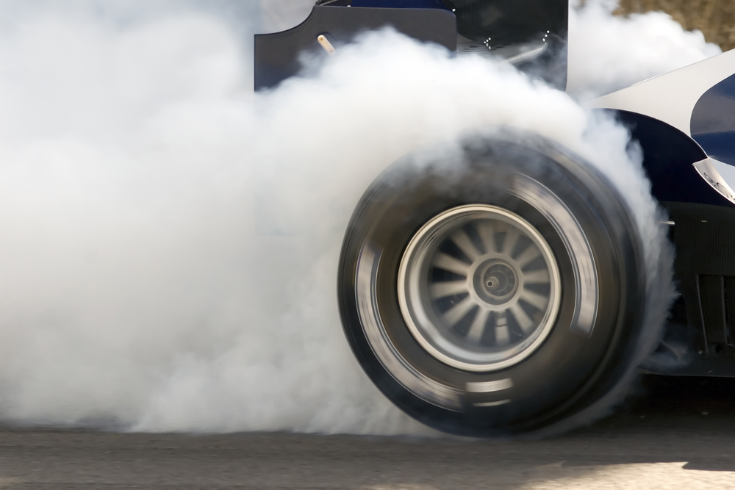
Simple acceleration problem
A racing car accelerates from rest to a velocity of 27 m/s in 2 seconds.
What is its acceleration?
change in speed
time taken
acceleration =
=
27
2
= 13.5 m/s²
Notes:
Photo: © Jaywarren79, Shutterstock.com 2011
13
Boardworks GCSE Additional Science: Physics
Acceleration

Slide 14
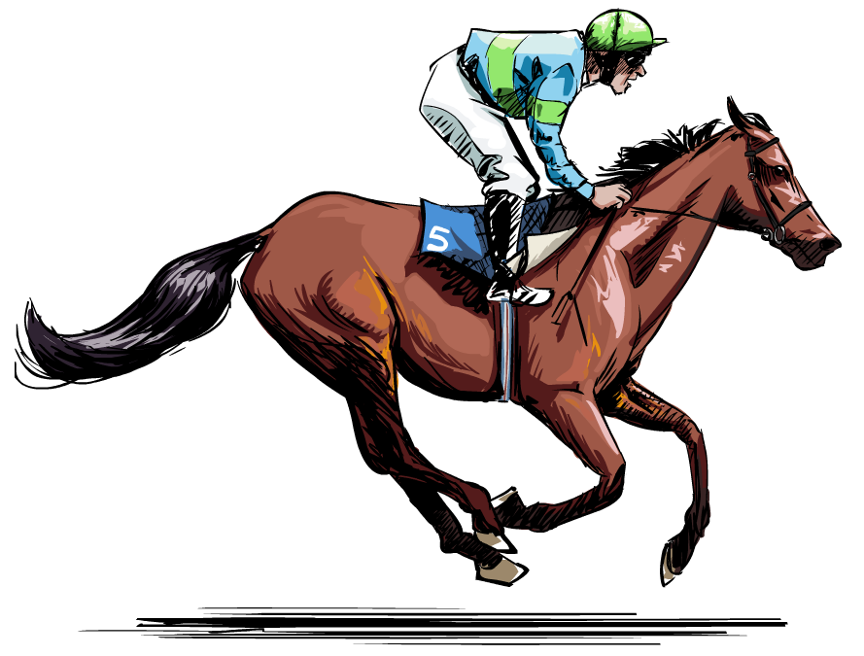
Acceleration problem
A race horse accelerates from 6 m/s to a speed of 12 m/s in a time of 4 seconds. What is the horse’s acceleration?
(v–u)
t
a =
12–6
4
=
= 1.5 m/s²
Notes:
14
Boardworks GCSE Additional Science: Physics
Acceleration

Slide 15
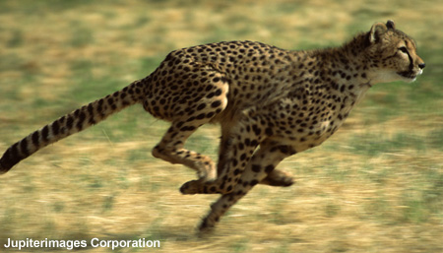
Extension question - Acceleration problem
A hungry cheetah spots a gazelle and decides to chase it. The cheetah accelerates at 10 m/s² from rest until it reaches 20 m/s. How long did this take?
change in speed
time taken
acceleration =
change in speed
acceleration
time taken =
=
20
10
= 2 s
Notes:
Photo credit: © 2007 Jupiterimages Corporation
15
Boardworks GCSE Additional Science: Physics
Acceleration

Slide 16
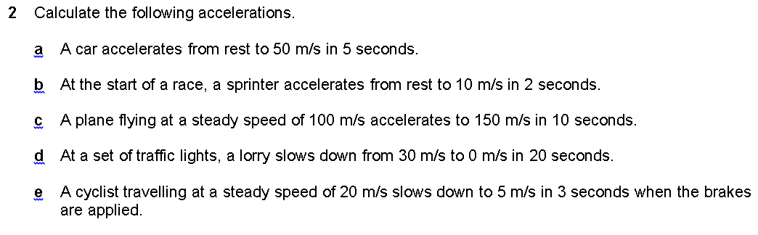

Slide 17
Now try the questions from the worksheet, then check your answers

Slide 18

Motion graphs quiz

Slide 19




Question 1
How do we calculate speed?
A
Speed = time/distance
B
Speed = time X distance
C
Speed = distance/time
D
Speed = distance X time

Slide 20

Wrong Answer!
Try Again

Slide 21
Question 2
A man walks 20 m in 10 seconds. What speed was he travelling?
A
2 m/s
B
5 m/s
C
20 m/s
D
200 m/s

Slide 22
Wrong Answer!
The correct answer is 2 m/s
20 / 10 = 2
Try Again

Slide 23
Question 3
A car travels for 10 seconds at 5 m/s. How much distance does it travel?
D
S
T
A
500 m
B
100 m
C
10 m
D
50 m

Slide 24
Wrong Answer!
The correct answer is 50 m
5 m/s X 10s = 50
D
S
T
Try Again

Slide 25
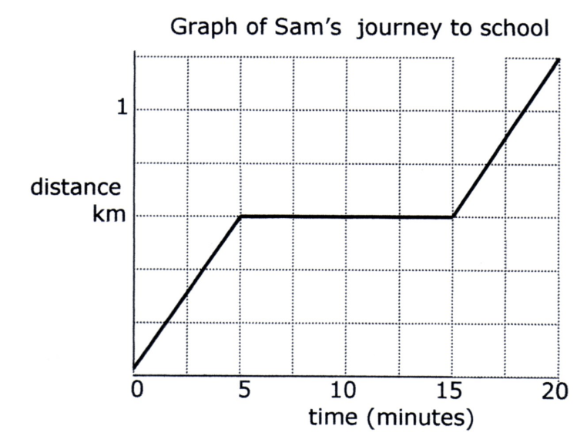
Question 4
What part of the graph indicated Sam stopped?
D
C
B
A
A
B
C
D

Slide 26
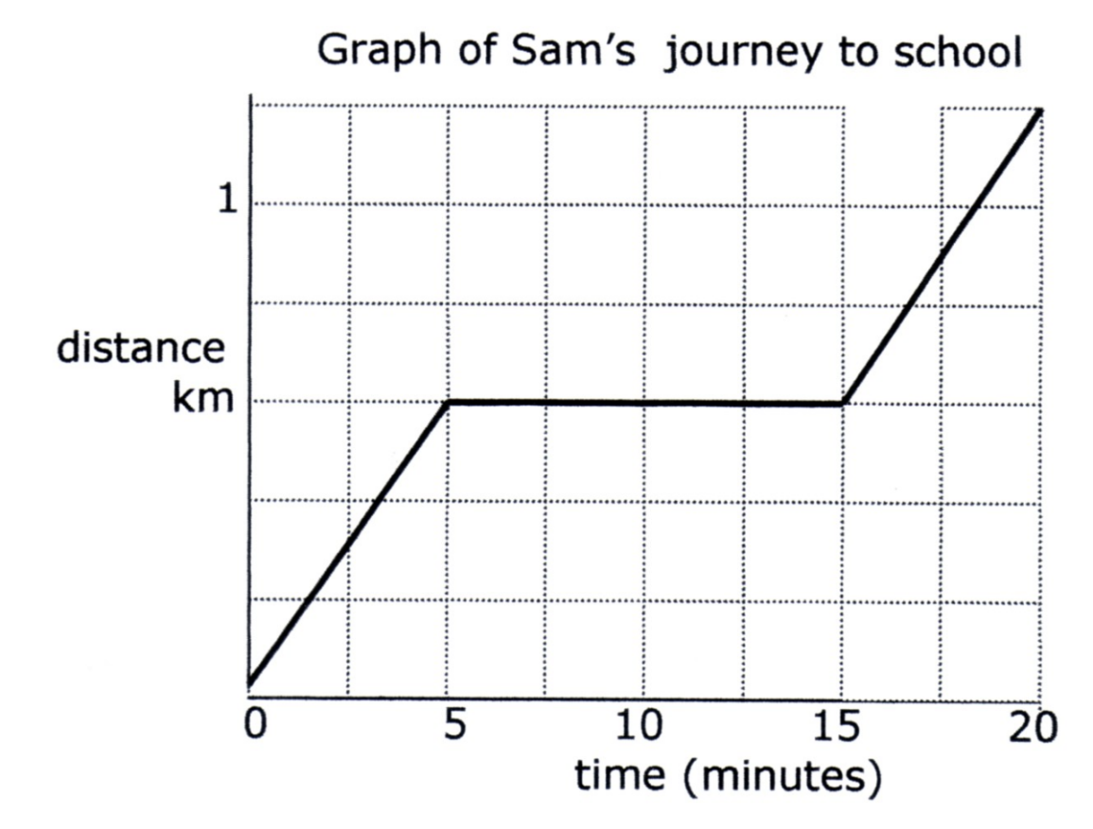
Wrong Answer!
The correct answer is C
Try Again

Slide 27
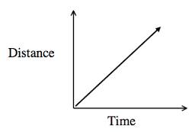
Question 5
In this graph, is the vehicle is.....
A
Moving at constant speed
B
Is not moving
C
Accelerating
D
braking

Slide 28
Incorrect!
The correct answer is moving at constant speed.
Try Again

Slide 29
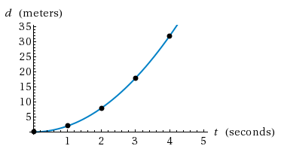
Question 6
Here the vehicle is.....
A
Is stationary
B
Moving at constant speed
C
Braking
D
Accelerating

Slide 30
Wrong Answer!
The correct answer is accelerating .
Try Again

Slide 31
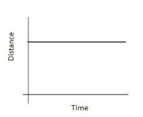
Question 7
Here the vehicle is?
A
At constant speed
B
Stopped
C
Braking
D
Accelerating

Slide 32
Wrong Answer!
The correct answer is the vehicle has stopped.
Try Again

Slide 33

End of quiz!

